Slide 1
An improved Id3 algorithm for clinical data classification
-Data Mining
119003228 N.L.Veerendra
119003080 K.Gangadhar
119003107 P.Rohith Surya
Smt. Kamakshi.S

Slide 2
An improved ID3 algorithm for clinical data classification based on
[Yang, Shuo, Jing-Zhi Guo, and Jun-Wei Jin. "An improved Id3 algorithm for medical data classification." Computers & Electrical Engineering 65 (2018): 474-487.](https://www.sciencedirect.com/science/article/pii/S004579061732517X "reference paper")

Slide 3
Data Cleaning
clean the data set by removing examples that have missing values.

Slide 4
Representation of the Data
attributes file: name-attributes.txt
training dataset file: name-train.csv
testing dataset file: name-test.csv

Slide 5
Attributes File
This file contains the list of all the attributes and their possible values (this will include the classifier and its values).
Each line in the attributes file should be in the format "attribute: _type of attribute_, value0, value1, ... valueN".
For example see the breast cancer attributes:
Clump Thickness:1,1,2,3,4,5,6,7,8,9,10
Cell Size:1,1,2,3,4,5,6,7,8,9,10
Cell Shape:1,1,2,3,4,5,6,7,8,9,10
Marginal Adhesion:1,1,2,3,4,5,6,7,8,9,10
Single Epithelial
Cell Size:1,1,2,3,4,5,6,7,8,9,10
Bare Nuclei:1,1,2,3,4,5,6,7,8,9,10

Slide 6
Contd: Attributes File
Bland Chromatin:1,1,2,3,4,5,6,7,8,9,10
Normal Nucleoli:1,1,2,3,4,5,6,7,8,9,10
Mitoses:1,1,2,3,4,5,6,7,8,9,10
Class:0,2,4
first value _type of attribute_ if _0_ then the attribute is nominal else if it is _1_ then it is numeric.
In above example the first zero in Class tells it is a nominal attribute

Slide 7
Dataset Files
Each of the dataset files should have a list of examples, with one example per line.
Each of the dataset files should have a list of examples, with one example per line. Each example is simply a comma-separated list of values, one for each attribute in the order provided in the attributes file.
There may also be a "name:" at the beginning of a line to use as a label for the data.
These labels are optional and simply for readability: they are thrown away by the parser. Three lines from a dataset of breast cancer may look like this:
patient_1:5,1,1,1,2,1,3,1,1,2
patient_2:5,4,4,5,7,10,3,2,1,2
patient_3:3,1,1,1,2,2,3,1,1,2

Slide 8
Contd: Dataset Files
Next, partition all the examples in two dataset files, one to use for training the decision tree algorithm (training set) and one for testing the effectiveness of trained tree (testing set).

Slide 9
Data Sets used for this Project
All the data sets are publicly available at: [UCI archive](https://archive.ics.uci.edu/ml/)
1.Acute inflammations
2. breast cancer (Wisconsin)
3. lung cancer
4. mammographic mass
5. statlog (Heart)

Slide 10
Decision Tree Creation and Testing
Improved Id3 algorithm is implemented to create a decision tree. It will accept a set of data in the format described in Data cleaning, and from that data produce a decision tree. It will also allow testing the accuracy of the decision tree by running test cases against the tree and comparing the decision tree's performance against the known classifications.
In some cases, It will run out of attributes before uniformly classifying the examples. The following are guidelines are followed in such cases
If it run out of attributes and there are examples with different classifications, it chooses the classification for which there are the most examples.
If there are a duplicate number of examples in more than one group, choose the greatest number of examples from the parent, recursing as needed. If all sets are equal up to the root, the population is probably too small, so choose the value that comes earliest in the alphabet.

Slide 11
Decision Tree Creation and Testing
If it has a subpopulation that has no examples for an attribute value, it chooses the most prevalent example from the population that falls into the parent's domain, as per guideline 1.

Slide 12
How to run the files
main.py: Provides a command-line interface to the decision tree.
It takes parameter for the decision tree algorithm module, and name of the classification attribute.
Invoke --help to see complete list of options.

Slide 13
usage: main.py [-h] [-d] -a ATTRIBUTES_FILE -l TRAINING_FILE [-t TESTING_FILE]
dtree-module classifier
Train (and optionally test) a decision tree
positional arguments:
dtree-module Decision tree module name
classifier Name of the attribute to use for classification
optional arguments:
-h, --help show this help message and exit
-d, --debug enables debug
-a ATTRIBUTES_FILE, --attributes ATTRIBUTES_FILE
Name of the attribute specification file
-l TRAINING_FILE, --train TRAINING_FILE
Name of the file to use for training/learning
-t TESTING_FILE, --test TESTING_FILE
Name of the file to use for testing

Slide 14
Decision tree representation
The format of the dump output for a __non-terminal__ node in the decision tree is:
attribute-name:attribute-value-1
attribute-name:attribute-value-2
...
attribute-name:attribute-value-n
A __terminal__ node is represented as:
<classification>
Each line is indented one space for each level it is below the first.

Slide 15
For example, consider the following decision tree for classifying brest cancer:
Cell Size
|
->1.0
|
-Bare Nuclei
|
->[1.0-4.0]
| |
| -><2>
->5.0
| |
| -Clump Thickness
| |
| ->[1.0-4.0]
| |
| -><2>
.
.
It would be represented as:
Cell Size:1.0
Bare Nuclei:[1.0-4.0]
<2>
Bare Nuclei:5.0
Clump Thickness:[1.0-4.0]
<2>
.
.

Slide 16
Implementation

Slide 17
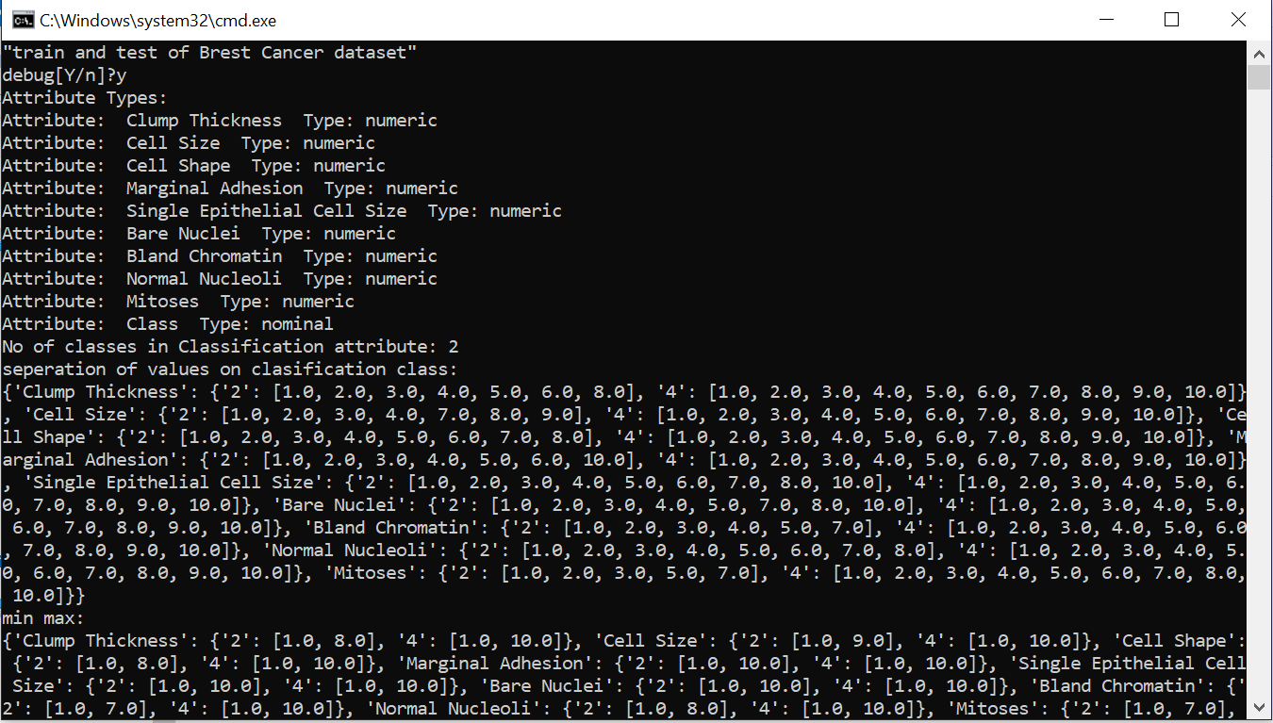

Slide 18
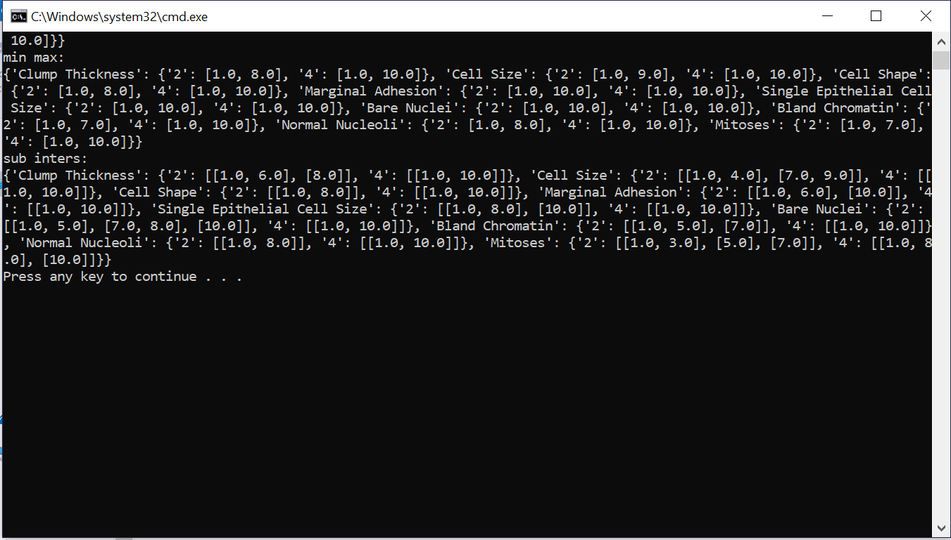

Slide 19
